Slide 1
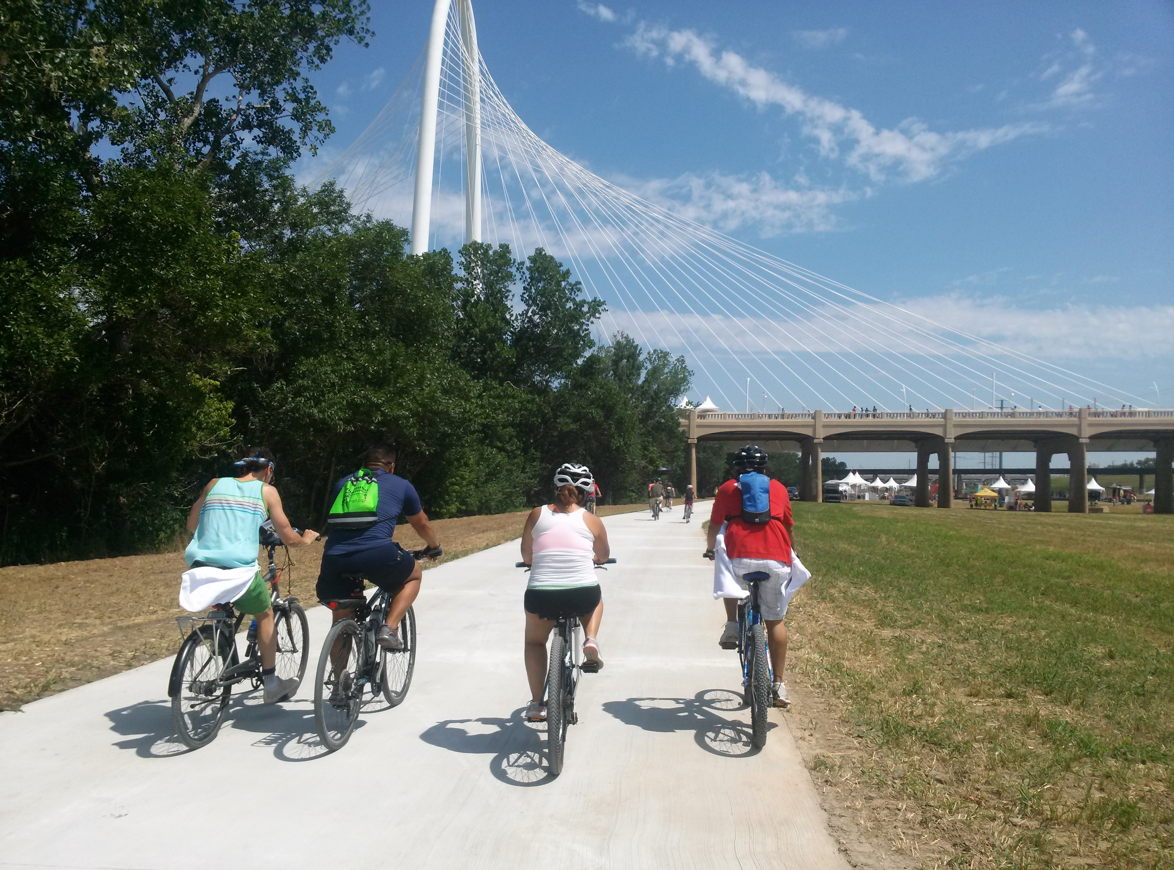


Trails and Bikeways Planning and Implementation in North Texas
TxDOT Bicycle Hearing | November 2024
Notes:
Add RTC logo if necessary

Slide 2
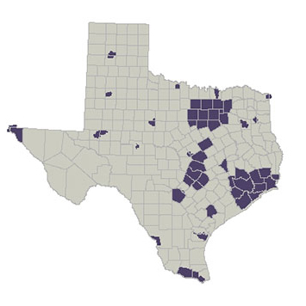
Texas Metropolitan Planning Organizations (MPO)
Abilene
Alamo Area
Amarillo
Austin
Beaumont – Port Arthur
Bryan – College Station
Corpus Christi
Dallas-Fort Worth
El Paso
Grayson County
Houston – Galveston
Killeen – Temple
Laredo & Webb County
Longview
Lubbock
Required of metropolitan areas with populations greater than 50,000
23 in Texas
400+ in the U.S.
Permian Basin
Rio Grande Valley
San Angelo
Texarkana
Tyler Area
Victoria
Waco
Wichita Falls

Slide 3
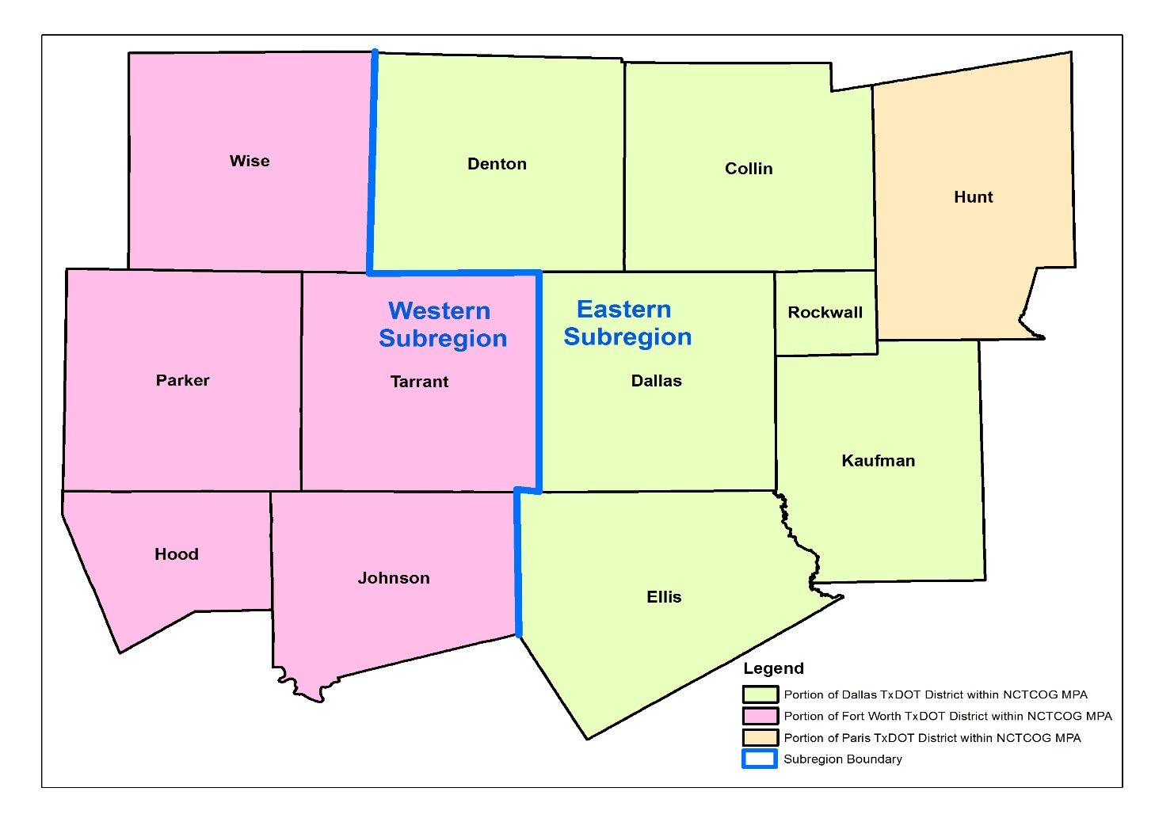
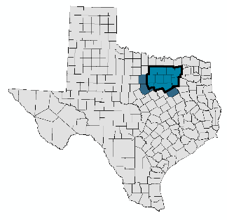
North Central Texas Council of Governments
Metropolitan Planning Organization (MPO) for the Dallas-Fort Worth Region
Portions of three TxDOT Districts
Dallas District
Fort Worth District
Paris District

Slide 4
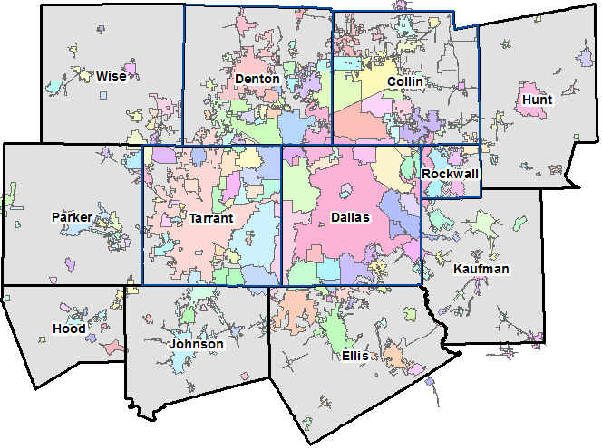
North Central Texas Council of Governments
Metropolitan Planning Organization for the Dallas-Fort Worth Region
Metropolitan Planning Area (MPA)
209 cities
15 cities larger than 100,000 pop.
MPA Population
2020 Estimate = 8.4 million
2045 Forecast = 11.4 million

Slide 5
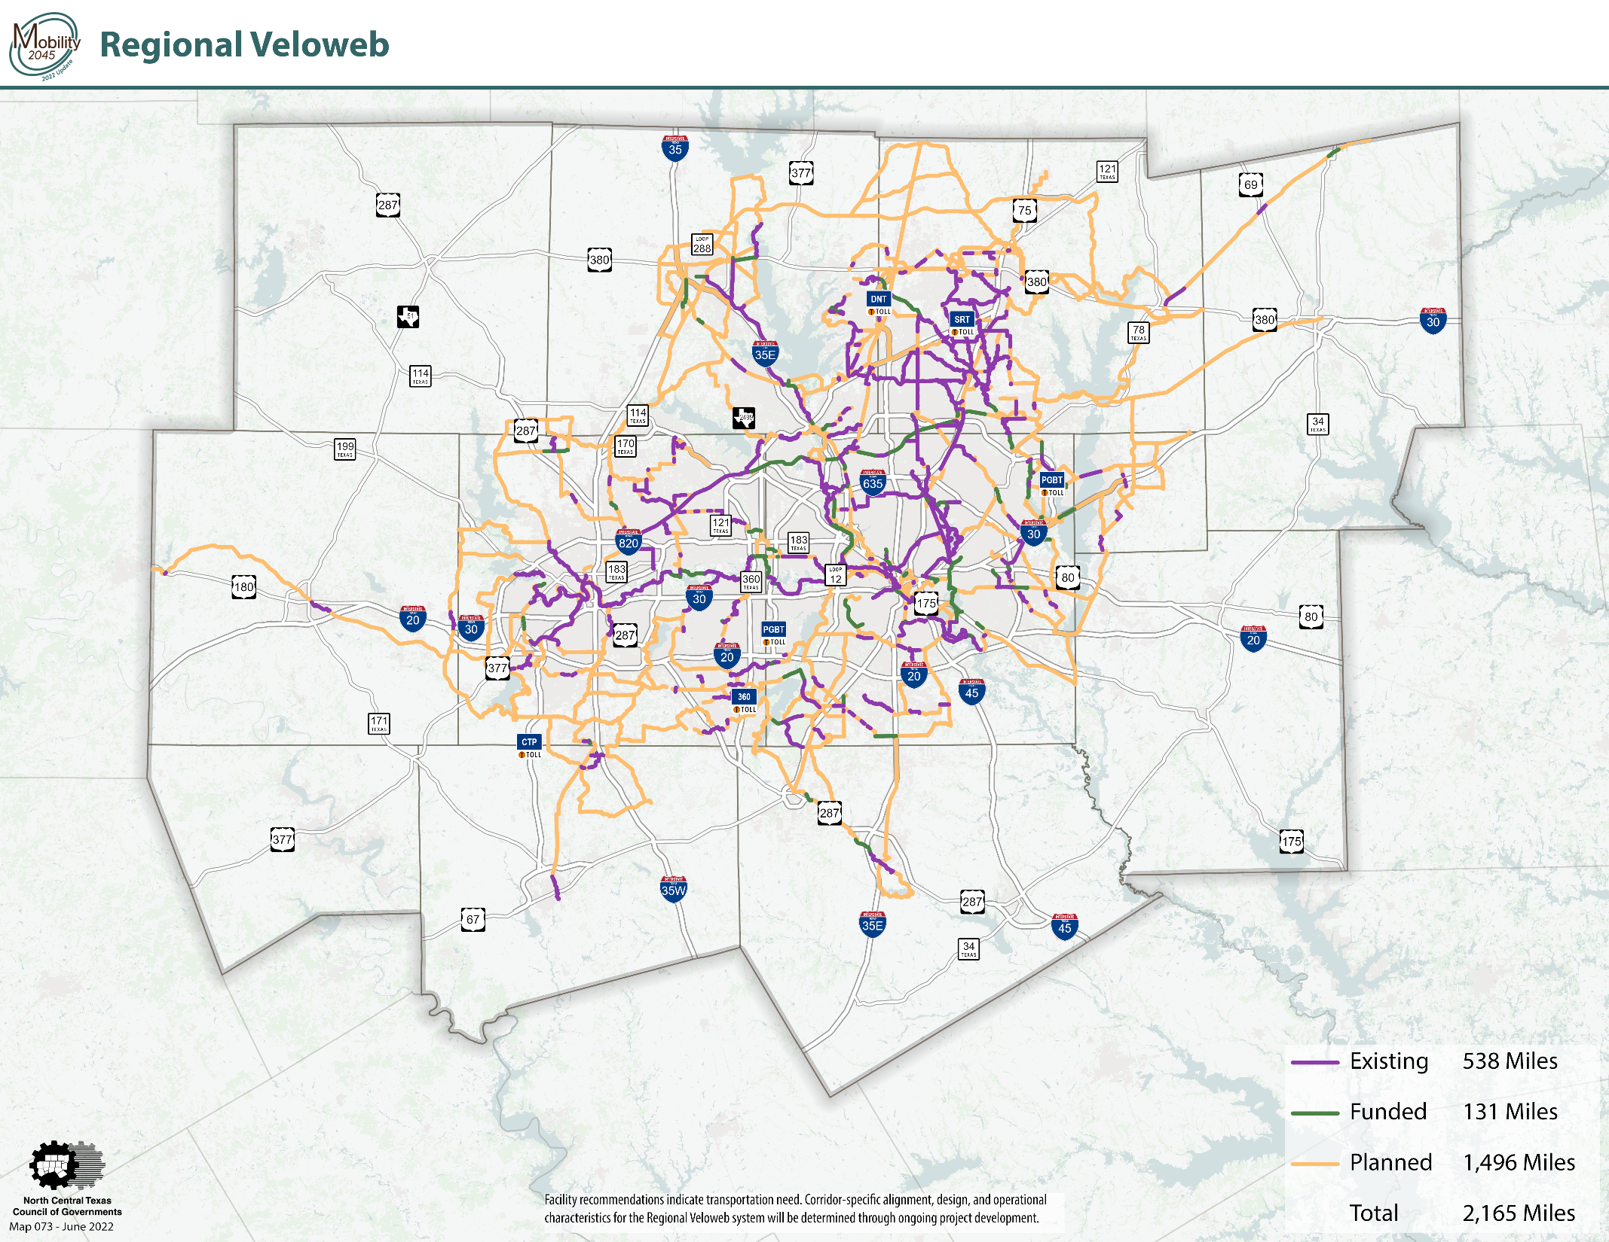

Slide 6
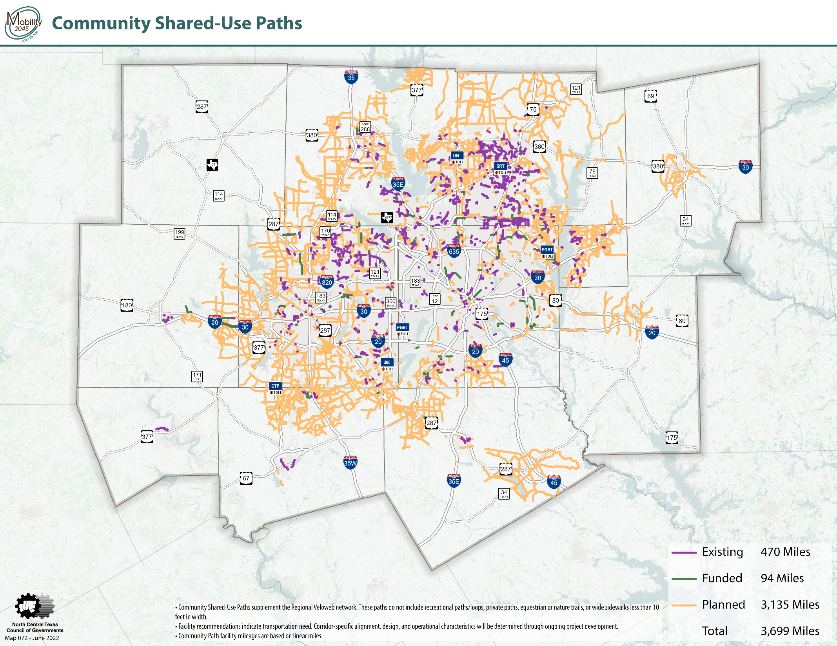

Slide 7
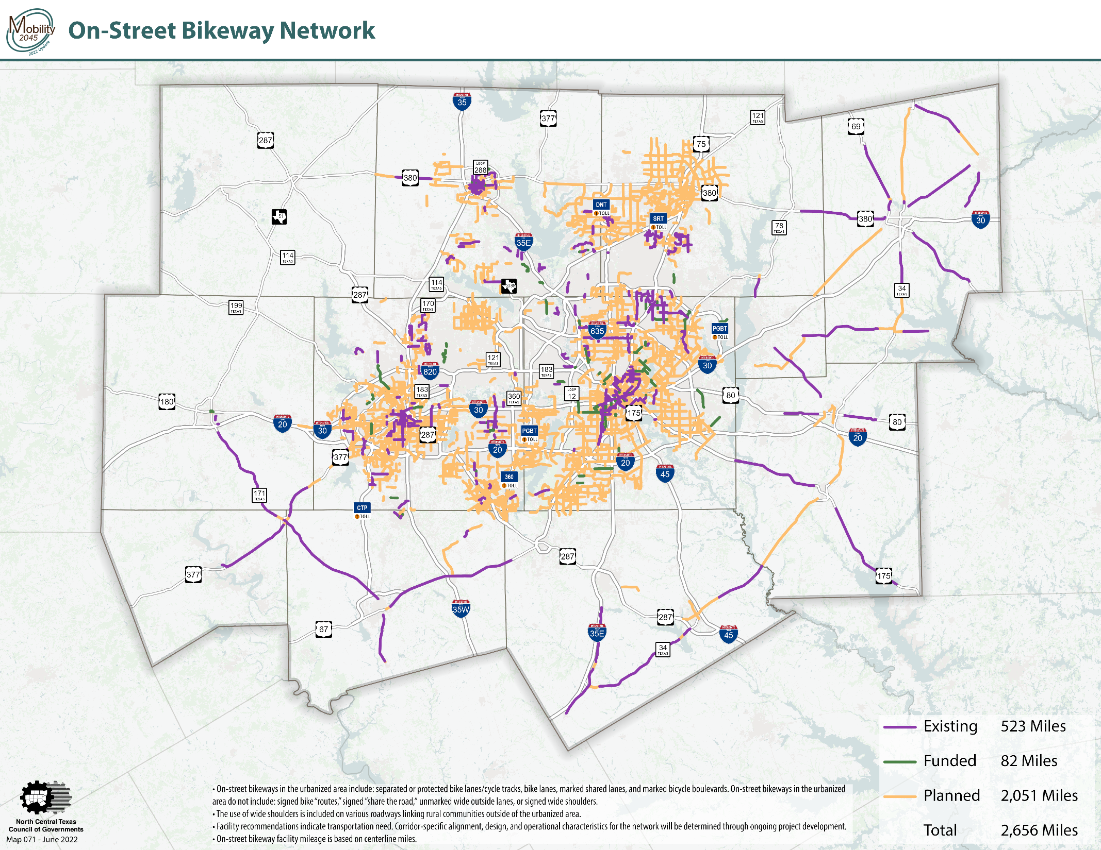

Slide 8
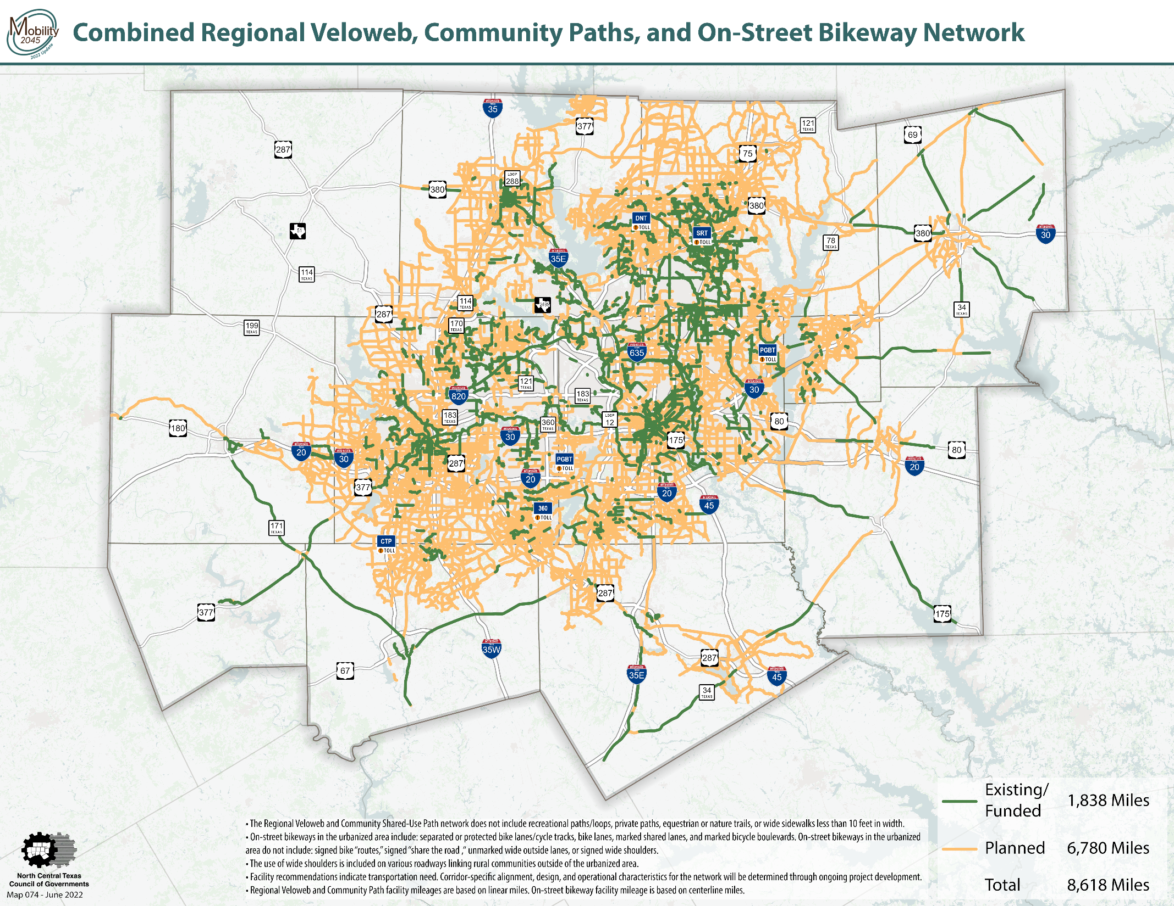

Slide 9
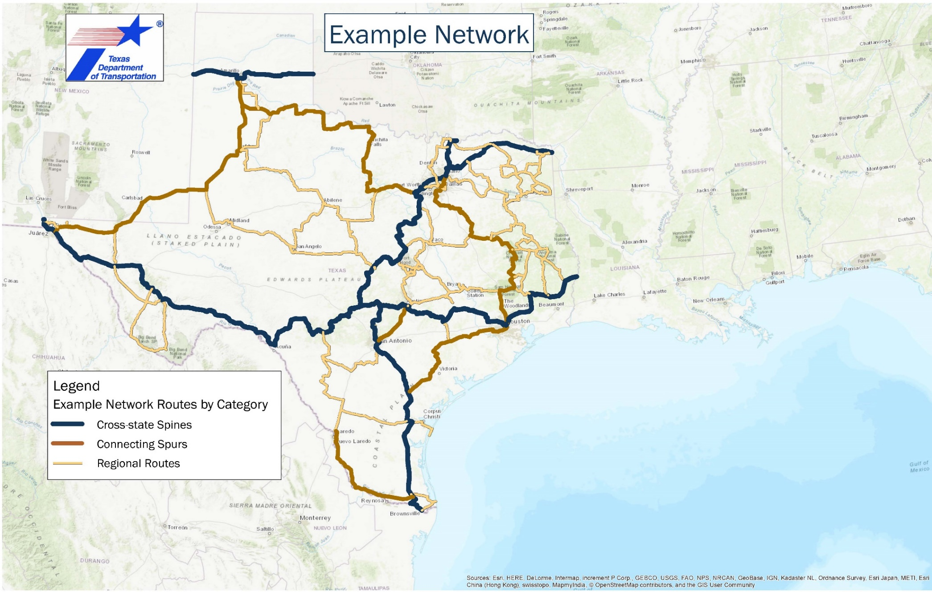
TxDOT Bicycle Tourism Trails Study
Trail alignments in the DFW metropolitan area are part of TxDOT’s Bicycle Tourism Trail Example Network

Slide 10
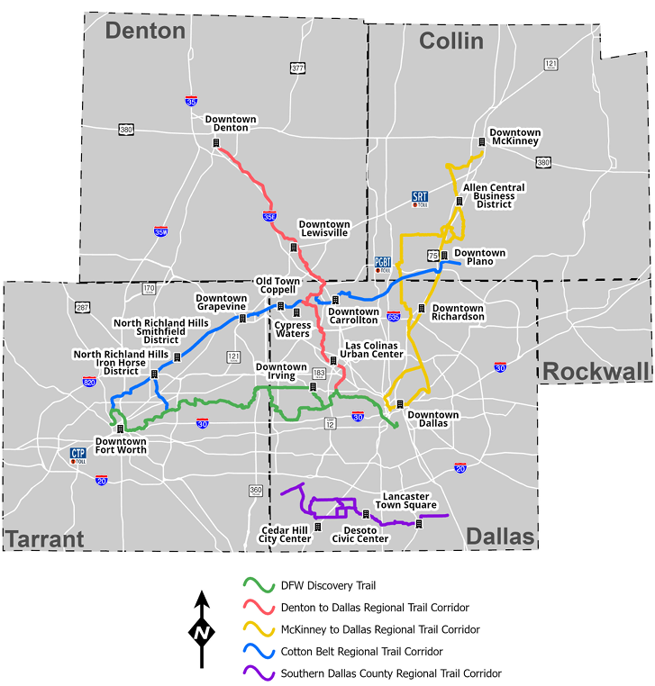
Highlighted Regional Trail Corridors
Existing/Funded | Planned | Total
61 miles | 3 miles | 64 miles
46 miles | 7 miles | 53 miles
64 miles | 15 miles | 79 miles
42 miles | 15 miles | 57 miles
20 miles | 18 miles | 38 miles
Trails and Bikeways Planning and Implementation in North Texas
10

Slide 11
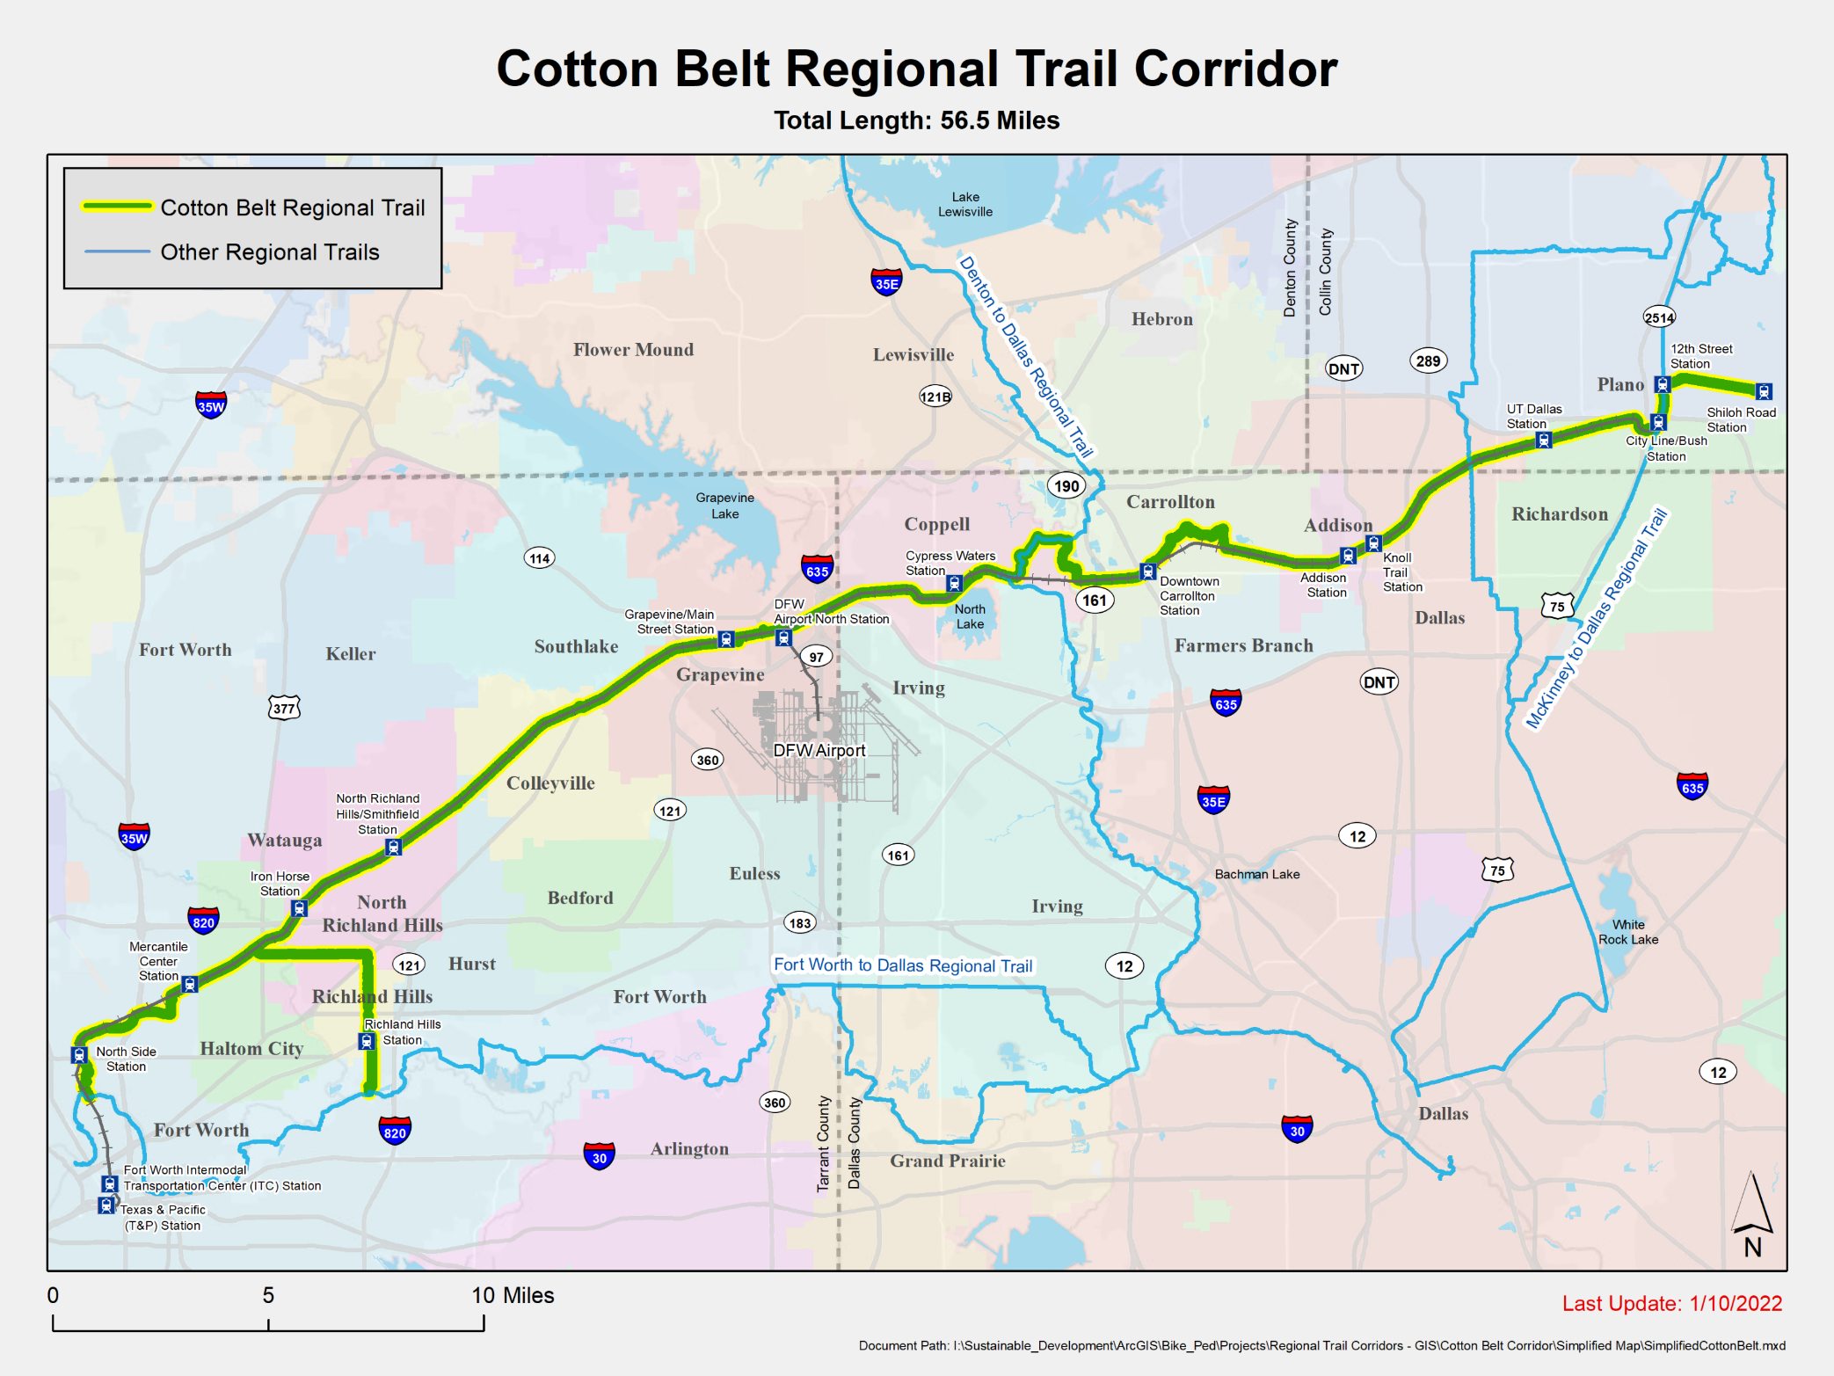
Cotton Belt Regional Veloweb Trail
Engineering Design Completed by DART
nctcog.org/CottonBeltTrail
Project Area | 57 miles
Counties | 3
Cities | 12
TEXRail Stations | 5
DART Silver Line Stations | 9
Existing Trail | 21 miles
Funded Trail | 22 miles
Planned Trail | 15 miles
Trails and Bikeways Planning and Implementation in North Texas

Slide 12
Highlighted Regional Trail Corridors
Existing/Funded | Planned | Total
61 miles | 3 miles | 64 miles
46 miles | 7 miles | 53 miles
64 miles | 15 miles | 79 miles
42 miles | 15 miles | 57 miles
20 miles | 18 miles | 38 miles
Trails and Bikeways Planning and Implementation in North Texas
12

Slide 13
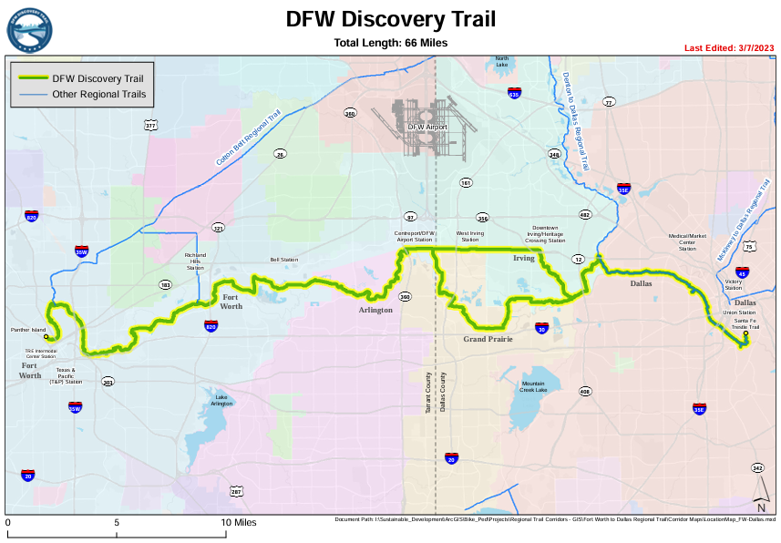
DFW Discovery Trail
nctcog.org/DFWDiscoveryTrail
Project Area | 64 miles
Counties | 2
Cities | 5
TRE Rail Stations | 3
Existing Trail | 49 miles
Funded Trail | 12 miles
Planned Trail | 3 miles
The segments connecting Fort Worth, Arlington, and Grand Prairie to CentrePort TRE rail station is currently under construction.
Trails and Bikeways Planning and Implementation in North Texas
13

Slide 14
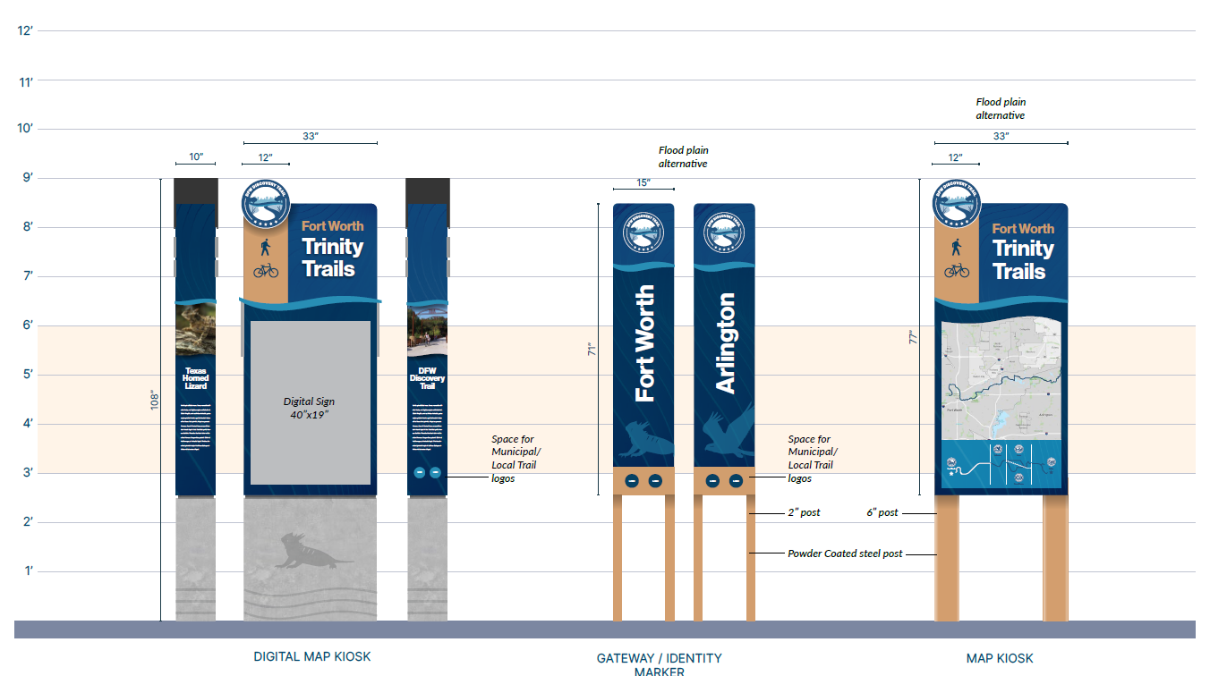
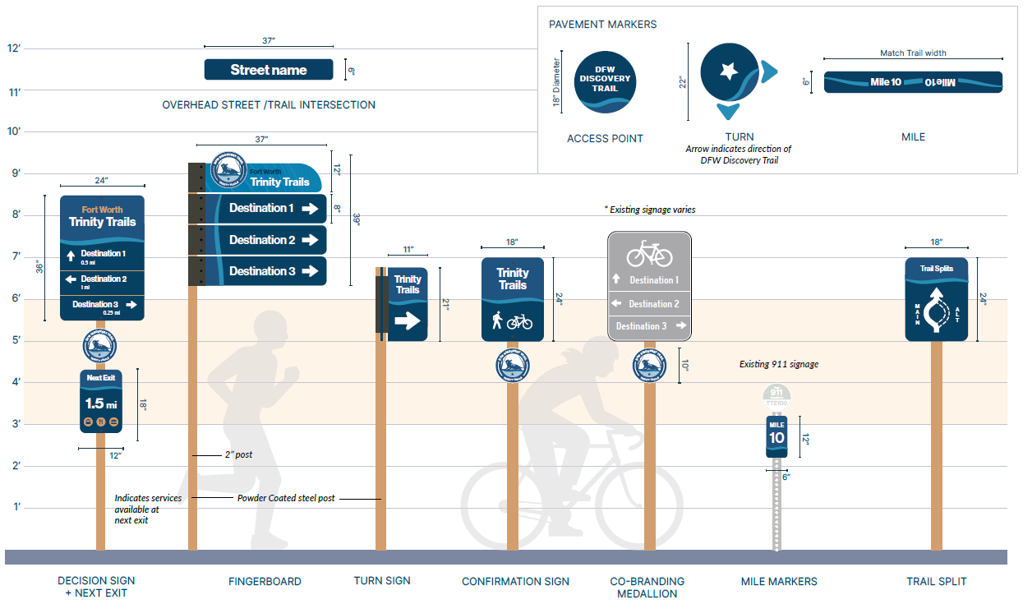
DFW Discovery Trail Wayfinding Signage
Access Elements
Functional and Enhanced Navigational Signs
Informational Kiosks
Trails and Bikeways Planning and Implementation in North Texas

Slide 15
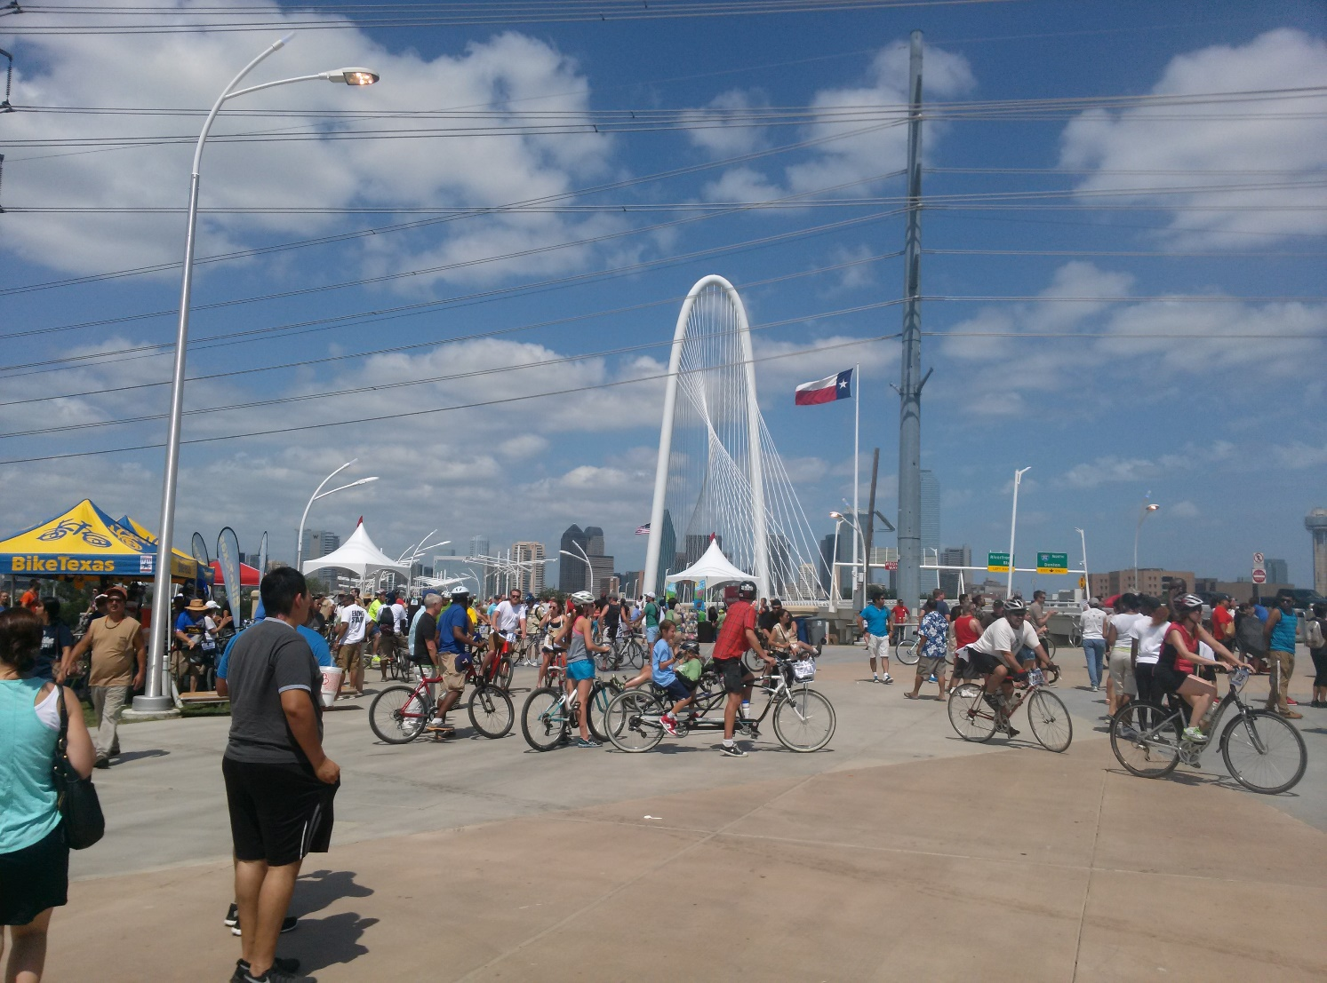
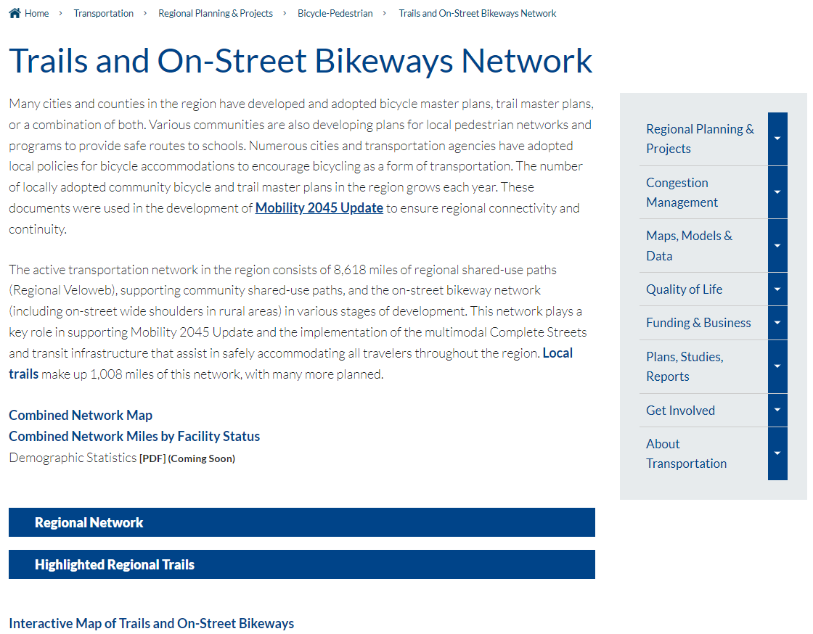
Regional Network: nctcog.org/Veloweb
Trails and Bikeways Planning and Implementation in North Texas
15

Slide 16


Contact Us
Daniel Snyder, AICP
Senior Transportation Planner
dsnyder@nctcog.org | 817-608-2394
Karla Windsor, AICP
Senior Program Manager
kwindsor@nctcog.org | 817-608-2376
Kevin Kokes, AICP
Program Manager
kkokes@nctcog.org | 817-695-9275
Jill Krauter
Planner I
jkrauter@nctcog.org | 817-704-5649
Catherine Richardson
Planner II
crichardson@nctcog.org | 682-433-0485

